Slide 1
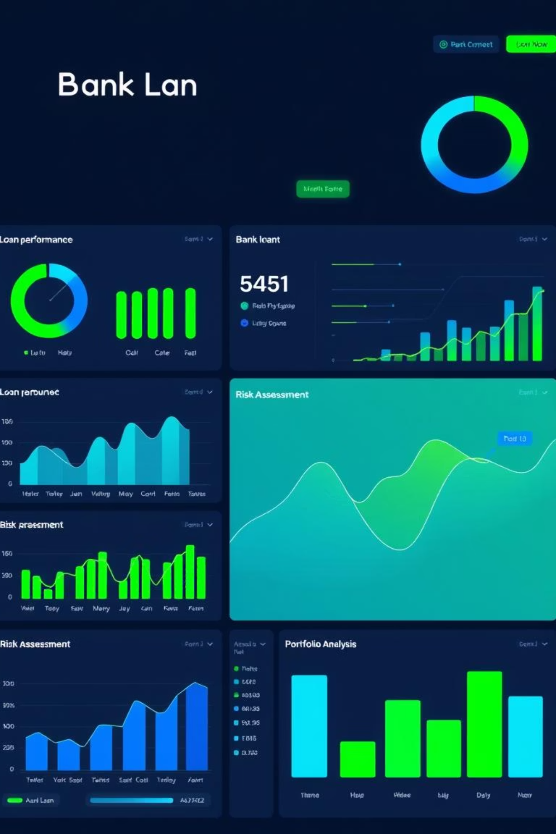
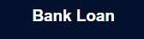


Lend-Sight: Interactive Bank Loan Analytics Dashboard
Capstone Project 1 using Power BI
Presented by: Vigneshwar Raipally

Slide 2
Objective
1
The goal of this project is to perform a comprehensive analysis of bank loan data to identify patterns, assess financial health, and gain insights into customer behavior. By leveraging SQL for backend validation, Python for scripting, and Power BI for visualization, the project aims to:
2
Understand key loan metrics and borrower profiles.
3
Identify trends in loan issuance and repayment behavior.
4
Differentiate between good and bad loans using KPIs.
5
Empower stakeholders to make data-driven lending decisions through an interactive dashboard.

Slide 3




Tools & Technologies Used
Database
MySQL (Data Import & Querying)
Scripting
Python (Data Pipeline via Jupyter Notebook)
Data Source
Visualization
bank_loan_new.csv
Power BI (Dashboard Creation, KPIs, Filters)

Slide 4
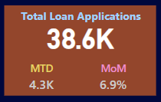
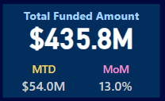
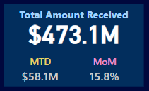
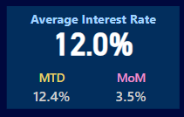
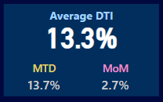

DASHBOARD 1: SUMMARY
1
Total Loan Applications
We need to calculate the total number of loan applications received during a specified period. Additionally, it is
essential to monitor the Month-to-Date (MTD) Loan Applications and track changes Month-over-Month (MoM).
2
Total Funded Amount
Understanding the total amount of funds disbursed as loans is crucial. We also want to keep an eye on the MTD
Total Funded Amount and analyse the Month-over-Month (MoM) changes in this metric.
3
Total Amount Received
Tracking the total amount received from borrowers is essential for assessing the bank's cash flow and loan
repayment. We should analyse the Month-to-Date (MTD) Total Amount Received and observe the
Month-over-Month (MoM) changes.
4
Average Interest Rate
Calculating the average interest rate across all loans, MTD, and monitoring the Month-over-Month (MoM)
variations in interest rates will provide insights into our lending portfolio's overall cost.
5
Average Debt-to-Income Ratio (DTI)
Evaluating the average DTI for our borrowers helps us gauge their financial health. We need to compute the
average DTI for all loans, MTD, and track Month-over-Month (MoM) fluctuations.

Slide 5
Good Loan v Bad Loan KPI’s
Good Loan
Bad Loan
1
Good Loan Application Percentage
1
Bad Loan Application Percentage
2
Good Loan Applications
2
Bad Loan Applications
3
Good Loan Funded Amount
3
Bad Loan Funded Amount
4
Good Loan Total Received Amount
4
Bad Loan Total Received Amount
Loan Status Grid View
In order to gain a comprehensive overview of our lending operations and monitor the performance of loans, we aim to create a grid view report categorized by 'Loan Status.’ By providing insights into metrics such as 'Total Loan Applications,' 'Total Funded Amount,' 'Total Amount Received,' 'Month-to-Date (MTD) Funded Amount,' 'MTD Amount Received,' 'Average Interest Rate,' and 'Average Debt-to-Income Ratio (DTI),' this grid view will empower us to make data-driven decisions and assess the health of our loan portfolio.

Slide 6
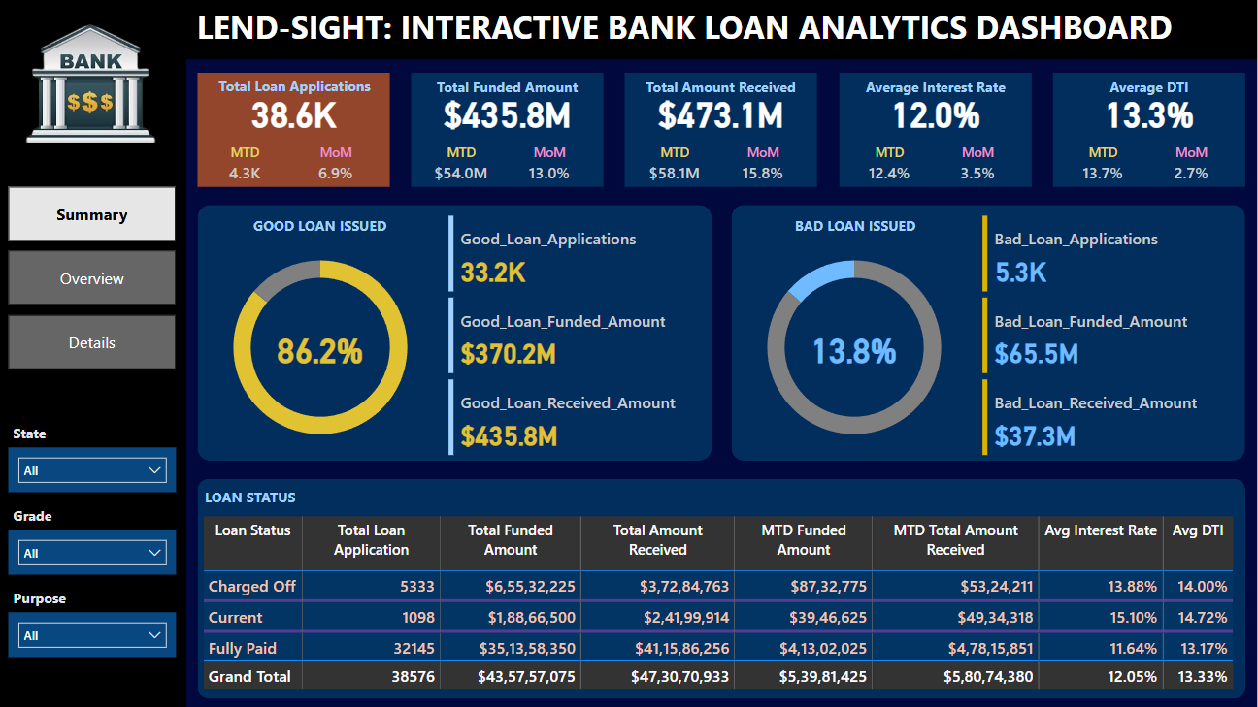
Summary Dashboard

Slide 7
DASHBOARD 2: OVERVIEW
CHARTS
1
Monthly Trends by Issue Date (Line Chart)
To identify seasonality and long-term trends in lending activities
2
Regional Analysis by State (Filled Map)
To identify regions with significant lending activity and assess regional disparities
3
Loan Term Analysis (Donut Chart)
To allow the client to understand the distribution of loans across various term lengths.
4
Employee Length Analysis (Bar Chart)
How lending metrics are distributed among borrowers with different employment lengths, helping us assess the impact of employment history on loan applications.
5
Loan Purpose Breakdown (Bar Chart)
Will provide a visual breakdown of loan metrics based on the stated purposes of loans, aiding in the understanding of the primary reasons borrowers seek financing.
6
Home Ownership Analysis (Tree Map)
For a hierarchical view of how home ownership impacts loan applications and disbursements.
Metrics to be shown: 'Total Loan Applications,' 'Total Funded Amount,' and 'Total Amount Received'

Slide 8
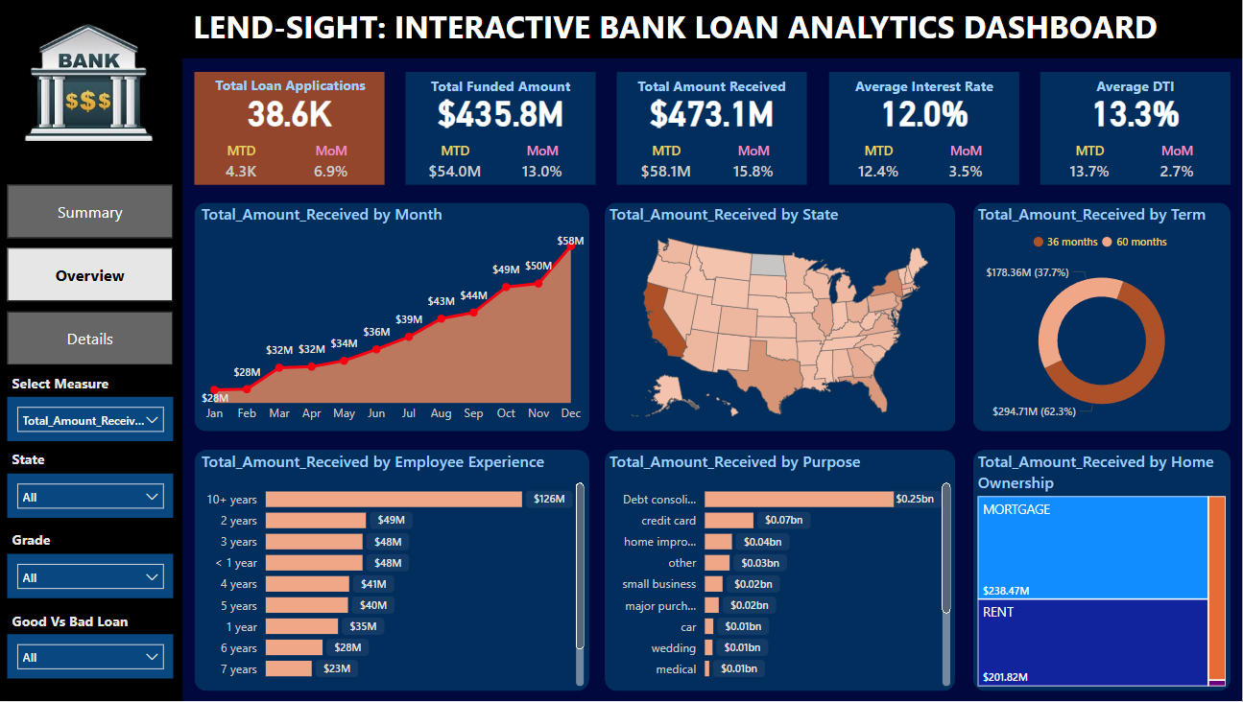

Slide 9
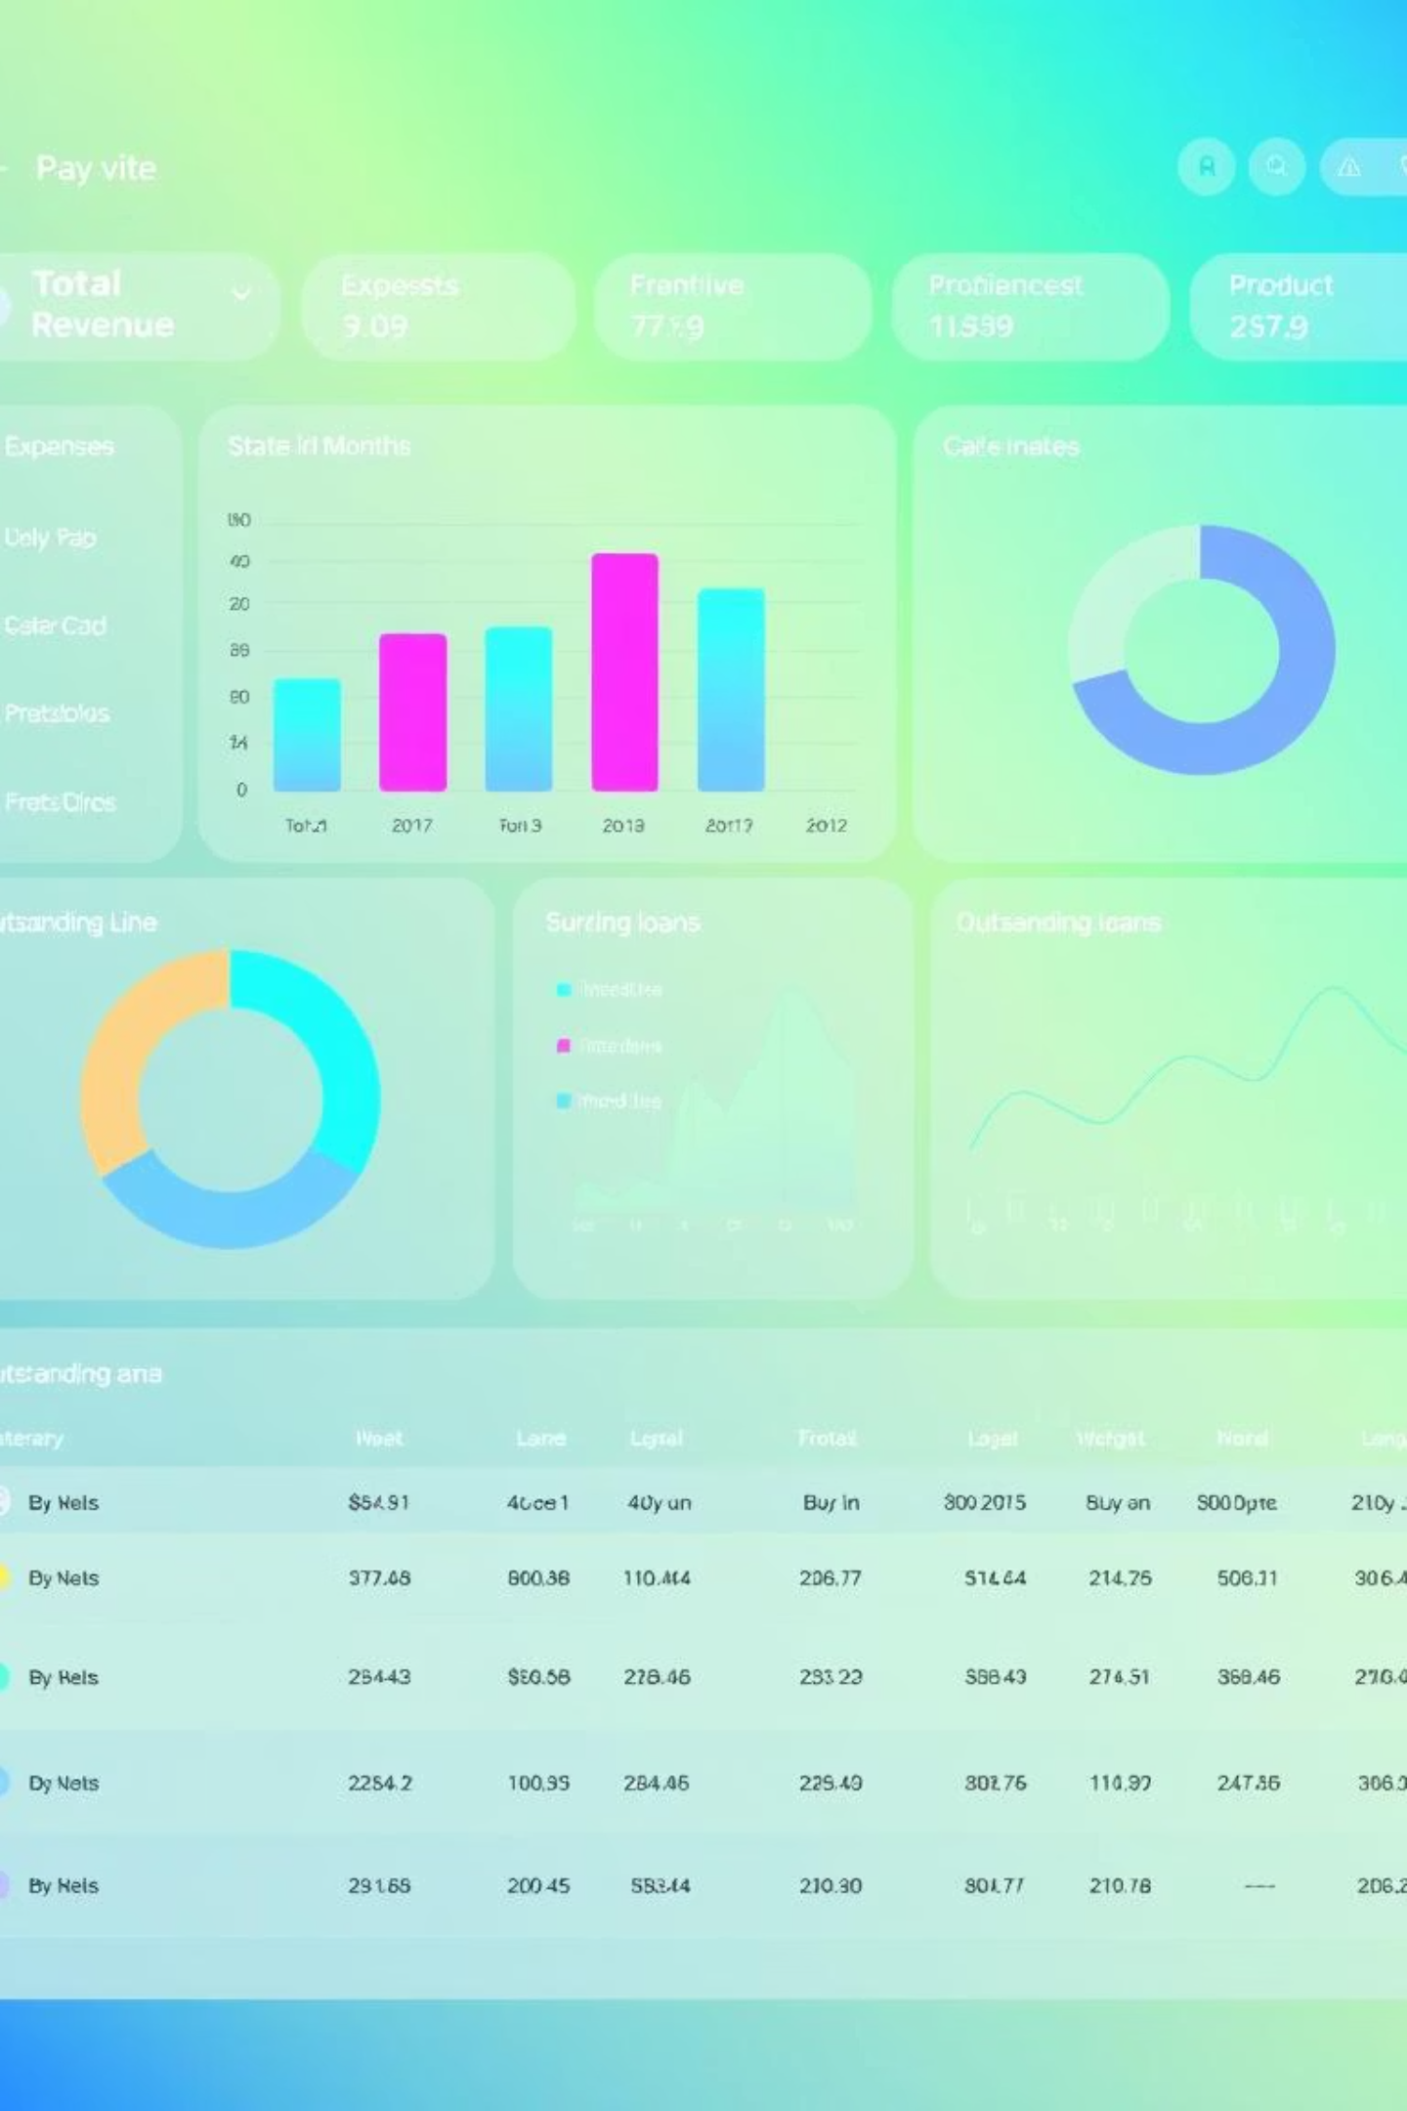
DASHBOARD 3: DETAILS
GRID
Need for a comprehensive 'Details Dashboard' that provides a consolidated view of all the essential information within our loan data. This Details Dashboard aims to offer a holistic snapshot of key loan-related metrics and data points, enabling users to access critical information efficiently.
Objective:
The primary objective of the Details Dashboard is to provide a comprehensive and user-friendly interface for accessing vital loan data. It will serve as a one-stop solution for users seeking detailed insights into our loan portfolio, borrower profiles, and loan performance.

Slide 10




Challenges Faced:
Data Format Discrepancies
Several date fields (e.g., issue_date, last_payment_date) were not in standard format and required conversion using SQL functions (STR_TO_DATE) before analysis.
Data Type Alignment
After importing into MySQL, some columns had incompatible datatypes (e.g., strings instead of dates or floats), affecting initial queries and Power BI import.
Cross-Tool Validation
Ensuring consistency between SQL query results and Power BI measures was time-consuming but necessary for accuracy.
Unbalanced Class Distribution
Good loans heavily outweighed bad loans, which skewed certain visual insights unless properly normalized.

Slide 11

Key Insights & Recommendations
Most loans were issued for debt consolidation.
Loans with grade A had lower default rates.
36-month terms had higher repayment percentages.
States like CA and TX had highest loan applications.

Slide 12
Conclusion
This capstone project successfully demonstrates the integration of data engineering, analysis, and visualization to build a robust business intelligence solution. By combining MySQL, Python, and Power BI:
1
A clear picture of loan performance was developed.
2
Data-driven recommendations can now be made to reduce risk and improve loan policies.
3
Business stakeholders can monitor financial KPIs in real-time.
4
The project also ensured analytical accuracy by validating dashboard metrics using SQL and Python independently. This holistic approach highlights the power of full-stack data analysis in driving meaningful business impact.

Slide 13





Real-World Applications:
Banking & Finance
Risk Management
Customer Segmentation
Enables banks to assess loan quality, detect high-risk segments, and refine loan approval criteria.
Helps risk analysts identify trends in defaults and preemptively act on patterns seen in bad loans.
Supports targeted marketing by identifying the most reliable borrower profiles (e.g., by state, purpose, or credit grade).
Policy Formulation
Operational Monitoring
Loan officers and financial institutions can base policy changes on insights from term-based or purpose-based performance.
With real-time filters and KPIs, operations teams can track performance MTD/PMTD and act quickly on underperforming metrics.

Slide 14


Slide 15
THANK YOU !!!

